Slide 1
Developing a Graphical User Interface for Econometric Analysis
rm2060

Slide 2
Overview
Work Completed
TImeLine

Slide 3
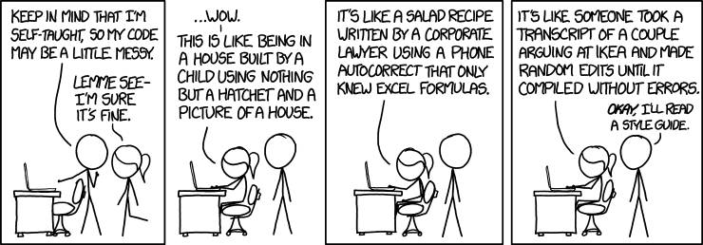
Overview
Develop a modular GUI tailored to the needs of econometricians, promoting :
Modularity: promote reuse, making it easy to save and reload specific analysis units
Reproducibility: allow users to document and share their pipeline easily
Notes:
Conducting econometric analyses often involves complex data manipulation, statistical modeling, and graph, however, many economists lack extensive software engineering skills, which can be a significant barrier to efficiently conducting econometric research. While econometricians may program in statistical software, often, the code is written in a ‘quick and dirty’ manner, without long term maintainability in mind, leading to code that is impossible to debug. Despite this, most popular econometrics programs are little more than a menu wrapped around a command line. While some point-and-click style Graphical User Interfaces exist, they are unpopular. Econometricians need to document every data transformation for replicability in empirical research. Point-and-click GUIs make this documentation challenging since they lack a proper way to track every action taken. The naive route most GUIs take is to log every action, however, this leads to messy documentation. In contrast, command-line systems usually rely on a single script to record all steps, making documentation straightforward.
My project aimed to develop a novel GUI tailored to the unique needs of econometricians, promoting modularity and reproducibility.

Slide 4
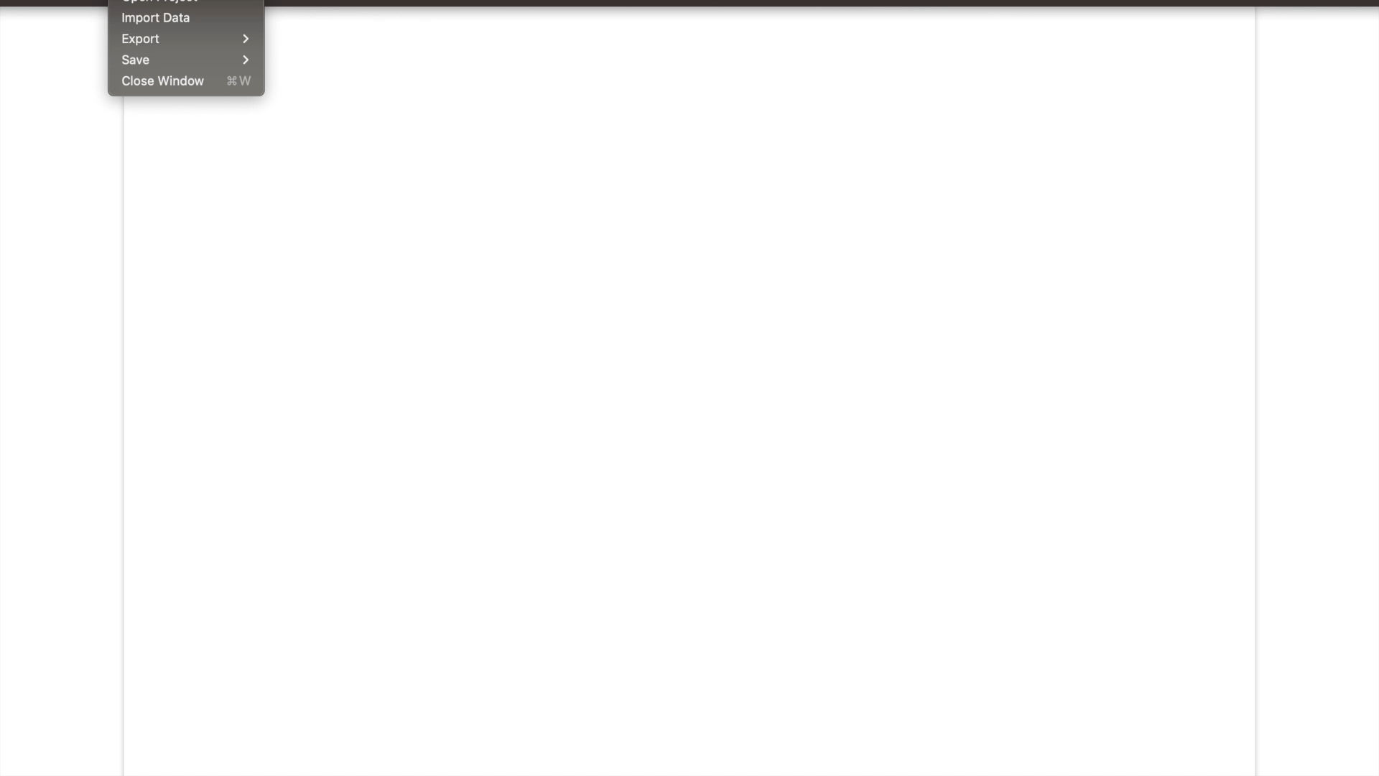
WORK Completed
Notes:
I have written two user profiles/personas, based on informal conversations with experts in the field and undergraduates studying Economics. I used these personas as the baseline for developing a user requirements document and wireframe for my GUI. The core Graphical User Interface has been designed, implemented, and tested. The GUI currently supports importing and exporting data in .csv and .xlsx formats and modelling single linear, single logarithmic, single polynomial and multiple linear regressions. The colour and size/shape of the regression graphs is customisable. Additionally, for multiple regression, I have included the option of using principle component analysis to reduce the dimensionality of the regression model. The GUI also includes templating features and has been thoroughly tested. I’ve also written comprehensive documentation for the core of the GUI.
I have also completed my first extension - extending the GUI to support network graph visual- isation, including running clustering and centrality algorithms on the network graph. I am now working on adding more functionality to the network graph, as well as providing more layout options to the user.

Slide 5
TimeLine
Notes:
Timeline wise, the project is just under 3 weeks ahead of schedule.

